Slide 1
Test Planning & Defect Management
420-E31 Systems III
References:
Crispins, Lisa & Gregory, Janet. Agile Testing: A Practical Guide for Testers and Agile Teams. 2009
Ron Patton. Software Testing. Second Edition. 2006

Slide 2
Test Case Design
A test case tests one particular situation or condition within the system being tested
System test case: meant to test the system as per the requirements; end to end

Slide 3
Requirements Traceability
Need to be able to follow chain from requirements, through test case design through test case implementation
Need to show that you have tested every requirement

Slide 4
Test Case Format
Test Case for
Test Case | Input Data | Calculation | Expected result | Checked
1
2
3
Note: Include as many test cases as necessary – not just 3

Slide 5
Test Execution
Need someone else to test the code that you write
Share testing responsibilities
“Bug Bash”
Beta Testing
Outsourcing Your Testing
Use whatever means are possible to be effective in your testing

Slide 6
Defect Logging and Tracking
Report bugs as soon as possible
Effectively describe the bugs
Be nonjudgmental when reporting bugs
Follow up on bug reports

Slide 7
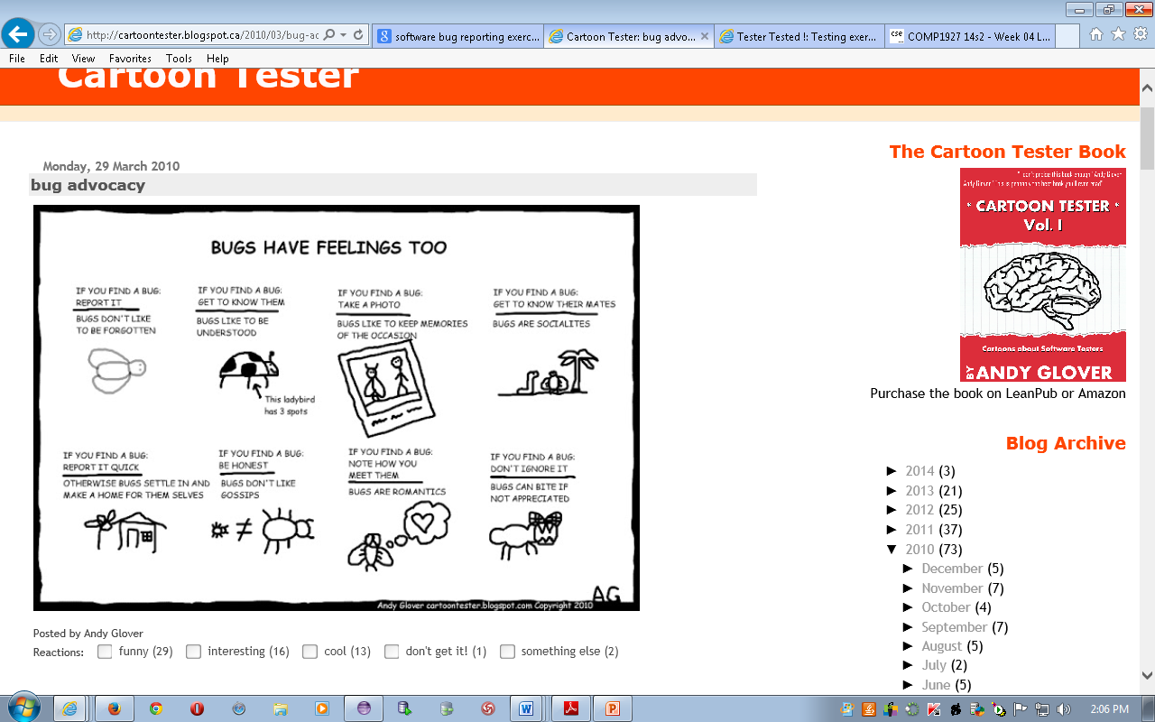
Notes:
Source: http://cartoontester.blogspot.ca/2010/03/bug-advocacy.html

Slide 8
Effective Bug Description
Unique identifier
Steps to reproduce
What you expected to see
What you saw instead – be specific and to the point
Notes:
Minimal
Just the facts and details needed to describe it
Singular
One bug per report
Obvious and General
Shortest path to finding the bug
Don’t give complex steps
Reproducible
Pre-defined steps to make it happen again
Don’t second-guess the programmer
You’re the tester, not the coder

Slide 9
Isolating and Reproducing
Try and narrow down cause of the bug
Some steps to help
Don’t take anything for granted
Look for time-dependent problems
White-box problems that are data overflows or memory leaks can take a while to show
Look for state problems (e.g. only occur first time it’s run)
Resource dependencies on test machine
Try to reproduce on different hardware
Still log the bug even if it cannot be reproduced

Slide 10
Interaction (Pair with a buddy)
Create bug descriptions for the following:
Available cash in user account is off by $20
Login expires in 25 minutes instead of 5
Footer links aren’t working, takes you to top of page
Button on main page is red instead of blue
The previous orders page takes 10 seconds to load
The header image is overlapping the navigation by 5 pixels

Slide 11
Severity/Priority
Severity indicates how bad the bug is and how it impacts the product and the user
Critical: software will not run
High: unexpected fatal errors (system crash or data loss)
Medium: a feature is malfunctioning
Low: a cosmetic issue
Technical perspective – how severe is the technical impact
Usually a number from 1-4
Notes:
Usually a number 1-4 or 5
Works together with priority

Slide 12
Interaction (Pair with a buddy)
List the severity of the following bugs:
User can’t log into the system
The main page takes 10 seconds to load
The main page takes 5 seconds to load
When placing an order, the server crashes and takes user to main page
User is getting two order confirmation emails
Can’t add product to the cart
Search page sorting isn’t working correctly

Slide 13
Severity/Priority
Priority indicates how important the bug is to fix and when it should be fixed
Immediate fix required, very visible
Must fix before release
Fix if time/schedule permits
Can be fixed post-release
Business perspective – how important is it to the business to fix it?
Usually a number from 1-4
Notes:
Usually a number 1-4 or 5
Priority is also often used for enhancement requests as well (same scale)

Slide 14
Interaction (Pair with a buddy)
List the priority of the following bugs, add any assumptions to your priorities:
User can’t log into the system
The main page takes 10 seconds to load
The main page takes 5 seconds to load
When placing an order, the server crashes and takes user to main page
User is getting two order confirmation emails
Can’t add product to the cart
Search page sorting isn’t working correctly

Slide 15
Severity/Priority Examples
Severity is absolute
Priority is relative
If a web page crashes when a link that is rarely used is clicked,
severity is high and priority is low
If the company name is misspelled in the home page of a web site,
severity is low and priority is high
Notes:
System Crash on Login – Sev 1, Priority 1
It’s 1970 and there is a known bug that will occur on January 1, 2000 – Sev 1, Priority 4
It’s December 1999 and the same thing…Sev 1, Priority 1
Spelling mistake on login page – Sev 3, Priority 1
Spelling mistake in user manual – Sev 3, Priority ??
Printing to Postscript printer does not work – Sev 2, Priority 2/3
Monitoring system occasionally does not log user password update, but password change occurs – Sev 3, Priority 3

Slide 16
Bug Tracking Systems
Also called issue tracking or defect tracking
Main features:
Issue management using a database
Project and user management
Customizable configuration
Administrator control
Reporting ability
Time tracking

Slide 17


Bug Tracking Systems
Examples:
Bugzilla (open source)
Mantis
Also included in products used at the college:
Team Foundation Server (part of Visual Studio 2012)
Notes:
Class activity: Brianstorm lifecycle of bugs in your very own company, should look like a state machine with transitions.
10 minutes, group activity, each group presents to class

Slide 18
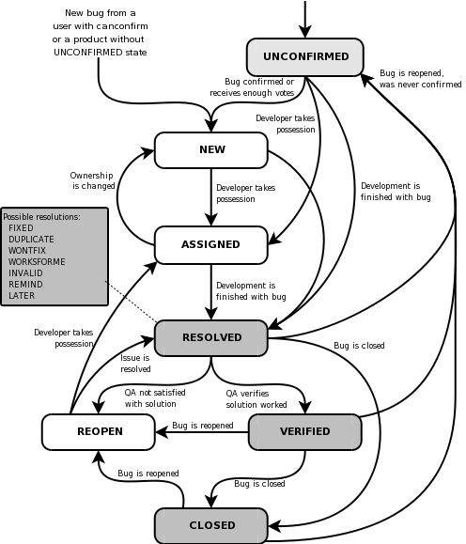
Lifecycle of a Bugzilla Bug
Source: http://www.bugzilla.org/docs/2.18/html/lifecycle.html
Notes:
Role playing: (Note: will need 25-35 minutes for this activity!)
Tester – finds bugs, generate bug report
Dev manager – triages, assigns prioritizes bugs (professor)
Developer – fixes bugs
Use a piece of paper to model ownership of the bug
Raise a bug. Simple page as token with
Bug #
Title
Severity
Priority
Build #, Environment
Description
Originator
Owner
Status
Sample bugs
Font not consistent with Corporate theme.
Crashes when click on rarely used link. Goes non-responsive.
Create user results in “ORA1090 Exception: Insert values Error…”
Workflow:
Normal, find and fix
Find but no fix, not reproducible
Find, fix, and fix rejected (still a problem)

Slide 19
Sample Bug Report
Bug Title:
Application crashes on clicking the SAVE button while creating a new user.

Slide 20
Sample Bug Report
Severity: HIGH or 1 Priority: HIGH or 1

Slide 21
Sample Bug Report
Description: Application crashed on clicking the SAVE button while creating a new user, hence unable to create a new user in the application.

Slide 22
Sample Bug Report
Steps To Reproduce: 1) Logon to the application 2) Navigate to the Users Menu > New User 3) Filled out all the user information fields 4) Clicked on ‘Save’ button 5) Saw error page “ORA1090 Exception: Insert values Error…” 6) See the attached logs for more information (Attach more logs related to bug..IF any) 7) And also see the attached screenshot of the error page.

